Slide 1


HUMAN-COMPUTER
INTERACTION
Usman Institute of Technology
FALL 2021
CS411 Human Computer Interaction
Lecture 12
Task Analysis

Slide 2
In Last Lecture
Goal-Directed Design Methodology
Notes:
1

Slide 3

Users
Provide input to
Provide feedback on usability to
Users
Provide bug report to
Designers
QA
Software
Development
Process
Provide mandate to
Provide spec to
Provide code to
Certify product for release
Managers
programmers
Primary responsibility:
Ensure financial success
Ensure customer satisfaction
Ensure performance
Ensure reliability
Initiate
Design
Code
Test
Ship

Slide 4
Goal-Directed Design Model
Research
User and the domain
Modeling
Users and use context
Requirements
Definition of user, business& technical needs
Framework
Definition of design structure & flow
Refinement
Of behavior, form& content

Slide 5
Goal-Directed Design Methodology
Users
Provide input to
Provide feedback on usability to
Users
Provide bug report to
Designers
QA
Software
Development
Process
Provide mandate to
Provide spec to
Provide code to
Certify product for release
Managers
programmers
Primary responsibility:
Ensure financial success
Ensure customer satisfaction
Ensure performance
Ensure reliability
Initiate
Design
Code
Test
Ship
Research and Modeling
Opportunities, Constraints, and
Context
Requirements, Framework
and Refinement
Form, Content, and Behavior
Tell stones about
Using the system
Refine detail,
describe models
Derive components
based on users
Review what exists
(e.g. documents)
Apply ethnographic
Research techniques
Imagine a system
To help users reach goals
Organize
the components
Discuss values,
Issues, expectations
Define typical
users
Define intent and
Constraints of project
Deduce what
users want
Scope
Audit
interviews
Observations
personas
Goals
Requirements
Scenarios
Elements
Framework
Spec
Desired outcomes
Time constraints
Financial constraints
General process
Milestones
(scope may be
Loose or tight)
Project Brief
Briefing
Business plan
Marketing plan
Branding strategy
Market research
Product plan
Competition
Related technology
Summary
Insights
Management
Domain experts
Customers
Partners
Sales channel
(this step leads to
a project mandate)
Tapes
Transcripts
Summary
Insights
Interview
Usage patterns
Potential users
Their activities
Their environments
Their interactions
Their objects(tools)
Aeiou framework from
Rick Robinson, sapient)
Tapes
Transcripts
Summary
Insights
Chalk Talk
(Early findings)
Primary
Secondary
Supplemental
negative]
Served(indirectly)
Partner
Customer
Organizational
Notes
Life
End
Experience
Business
Technical
Notes
Chalk talk with
management
Problem definition
vision definition
Design imperatives
Functional & data needs
Environmental factors
Business requirements
Technical constraints
(may require changes
in scope)
Problem statement
Vision statement
Cost of persons
Formal decimations
Presentation
Context
Key-path
Validation
key path variants
necessary use
edge case use
Notes
Storyboards
Information objects
Functional objects
Functional actions
Contexts of use
Lists
Sketches
Diagrams
High-level
data models
Object relationship
Conceptual groupings
Principles
Patterns
Logic/narrative flow
Navigation structure
Sketches
Flow diagrams
Chalk talk with
Programmers
Appearance
Language
Flow/behavior
Product character
Product story
Format document
Demonstration
Prototype
Presentation

Slide 6
Goal-Directed Design combines techniques of
  ethnography,
  stakeholder interviews,
  market research,
  product/literature reviews,
  detailed user model,
  scenario-based design, and a
  core set of interaction principles and patterns.
  It provides solutions that meet the needs and goals of users, while also addressing business/organizational and technical imperatives.
  This process can be roughly divided into five phases:

Slide 7
Goal-Directed Design Model
Research
User and the domain
Modeling
Users and use context
Requirements
Definition of user, business& technical needs
Framework
Definition of design structure & flow
Refinement
Of behavior, form& content

Slide 8
What is Task Analysis?
Methods to analyze people's jobs:
  what people do
  what things they work with
  what they must know

Slide 9
An Example
in order to clean the house
    get the vacuum cleaner out
    fix the appropriate attachments
    clean the rooms
    when the dust bag gets full, empty it
    put the vacuum cleaner and tools away
must know about:
    vacuum cleaners, their attachments, dust bags,
    cupboards, rooms etc.

Slide 10
Approaches to task analysis
Task decomposition
  splitting task into (ordered) subtasks
Knowledge based techniques
  what the user knows about the task
  and how it is organised
Entity/object based analysis
  relationships between objects, actions and the people who perform them
lots of different notations/techniques

Slide 11
Differences from other techniques
Systems analysis vs. Task analysis
system design - focus - the user
Cognitive models vs. Task analysis
internal mental state - focus - external actions
practiced `unit' task - focus - whole job

Slide 12
Task Decomposition
Aims:
describe the actions people do
structure them within task subtask hierarchy
describe order of subtasks
Variants:
Hierarchical Task Analysis (HTA)
most common

Slide 13
Textual HTA description
Hierarchy description ...
0. in order to clean the house
1. get the vacuum cleaner out
2. get the appropriate attachment
3. clean the rooms
3.1. clean the hall
3.2. clean the living rooms
3.3. clean the bedrooms
4. empty the dust bag
5. put vacuum cleaner and attachments away
... and plans
Plan 0: do 1 - 2 - 3 - 5 in that order. when the dust bag gets full do 4
Plan 3: do any of 3.1, 3.2 or 3.3 in any order depending
on which rooms need cleaning
N.B. only the plans denote order

Slide 14
Generating the hierarchy
1 get list of tasks
2 group tasks into higher level tasks
3 decompose lowest level tasks further
Stopping rules
How do we know when to stop?
Is “empty the dust bag” simple enough?
Purpose: expand only relevant tasks

Slide 15

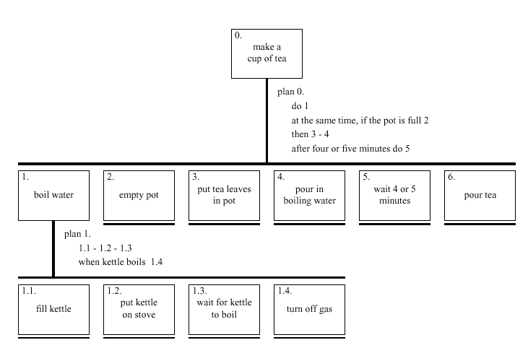

Slide 16
Refining the description
Given initial HTA (textual or diagram)
  How to check / improve it?
Some heuristics:
  paired actions e.g., where is `turn on gas'
  restructure e.g., generate task `make pot'
  balance e.g., is `pour tea' simpler than making pot?
  generalise e.g., make one cup ….. or more

Slide 17

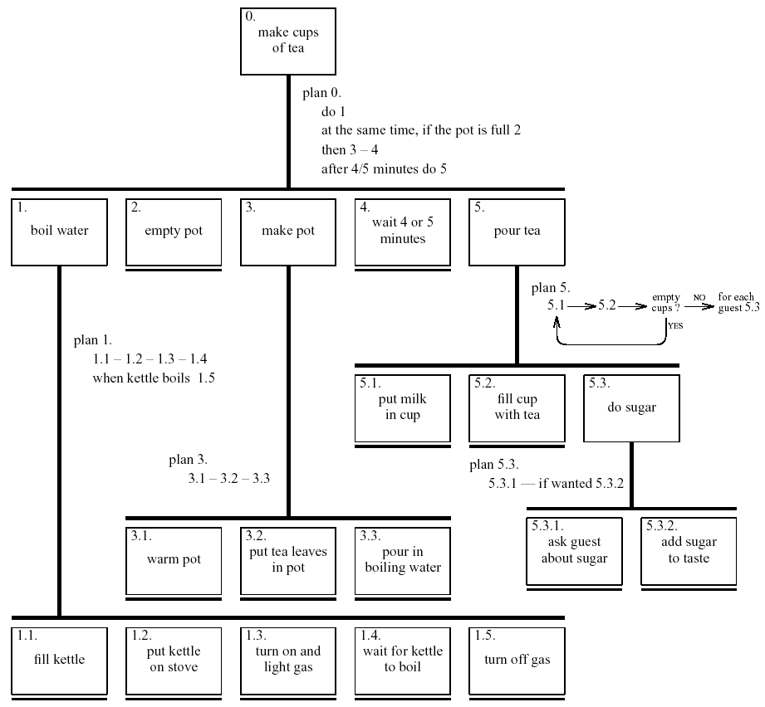

Slide 18
Types of plan
fixed sequence - 1.1 then 1.2 then 1.3
optional tasks - if the pot is full 2
wait for events - when kettle boils 1.4
cycles - do 5.1 5.2 while there are still empty cups
time-sharing - do 1; at the same time ...
discretionary - do any of 3.1, 3.2 or 3.3 in any order
mixtures - most plans involve several of the above

Slide 19

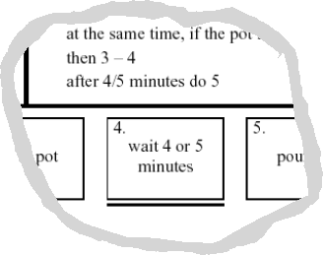
waiting …
is waiting part of a plan?
… or a task?
generally
  task – if ‘busy’ wait
    you are actively waiting
  plan – if end of delay is the event
    e.g. “when alarm rings”, “when reply arrives”
in this example …
  perhaps a little redundant …
  TA not an exact science

Slide 20
Tutorials
Produce a high level hierarchical task analysis showing how you would find information on a website. Assume the site has a facility as well as normal links.

Slide 21
0. find information on site
1. Find right page
2. Read page
1.1 look for direct link
1.2 use website search
1.1.1 scan page for link
1.1.2 click link
1.2.1 enter keyword
1.2.2 press ‘Go’
1.2.3 choose from results

Slide 22
Exercise
Produce a high-level HTA showing how to borrow a book from library

Slide 23
Example Hierarchical Task Analysis
0. In order to borrow a book from the library
1. go to the library
2. find the required book
2.1 access library catalogue
2.2 access the search screen
2.3 enter search criteria
2.4 identify required book
2.5 note location
3. go to correct shelf and retrieve book
4. take book to checkout counter

Slide 24
Example Hierarchical Task Analysis (plans)
plan 0: do 1-3-4. If book isn’t on the shelf expected, do 2-3-4.
plan 2: do 2.1-2.4-2.5. If book not identified do 2.2-2.3-2.4.

Slide 25
Example Hierarchical Task Analysis (graphical)
Borrow a book from the library
0
plan 0:
do 1-3-4.
If book isn’t on the shelf expected, do 2-3-4.
go to the library
find required book
retrieve book from shelf
take book to counter
1
2
3
4
plan 2:
do 2.1-2.4-2.5.
If book not identified from information available, do 2.2-2.3-2.4-2.5
access catalog
access search screen
enter search criteria
identify required book
note location
2.1
2.2
2.3
2.4
2.5

Slide 26
Produce a HTA to buy a laptop via online shopping website

Slide 27
Example Hierarchical Task Analysis
0. In order to buy a Laptop
  1. locate Laptop
  2. add Laptop to shopping basket
  3. enter payment details
  4. complete address
  5. confirm order
plan 0: If regular user do 1-2-5.
If new user do 1-2-3-4-5.

Slide 28
Example Hierarchical Task Analysis (graphical)
0. Buy Laptop
1. Locate
2. Add Laptop to Shopping basket
3. Enter Payment Details
4. Complete Address
5. Confirm Order

Slide 29
Consider the travel organizer again and perform hierarchical task analysis for the goal of identifying a vacation. Include all plans in your answer. Express the task analysis textually and graphically.

Slide 30
Example Hierarchical Task Analysis
0. In order to identify potential holiday options:
1. compile a set of initial criteria
2. compile a set of constraints
3. identify potential holiday
3.1 identify potential destinations
3.2 investigate facilities at potential destination
3.3 identify holiday companies operating at potential destinations
3.4 check availability of potential holiday
3.5 print holiday option details
4. decide on preferred holiday
5. book holiday

Slide 31
Example Hierarchical Task Analysis (plans)
plan 0: do 1-2-3. Repeat 3 until several potential holidays are available or no more potential holiday can be found. If one or more potential holidays is available, do 4-5. if no potential are available, repeat plan 0.
plan 3: do 3.1-3.2-3.3-3.4 or do 3.1-3.3-3.2-3.4 or do 31.-3.3-3.4-3.2. if potential holiday available do 3.5

Slide 32
Example Hierarchical Task Analysis (graphical)
0
1
2
3
4
5
3.1
3.2
3.3
3.4
5.5

Slide 33
Summary
Getting requirements right is crucial
There are different kinds of requirement, each is significant for interaction design
The most commonly-used techniques for data gathering are: questionnaires, interviews, focus groups, direct observation, studying documentation and researching similar products
Scenarios, use cases and essential use cases can be used to articulate existing and envisioned work practices.
Task analysis techniques such as HTA help to investigate existing systems and practices

